Slide 1
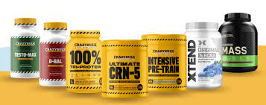
Supplements for muscle building
Building muscle can often be hard. Everybody knows somebody who just has to look at the weight rack to get big, but for those not as genetically gifted, getting your muscle building supplement strategy right can really help.
If you want to make the most of your training sessions, then knowing how your body builds muscle, and which performance-enhancing supplements can support your specific goals, will be very helpful.

Slide 2
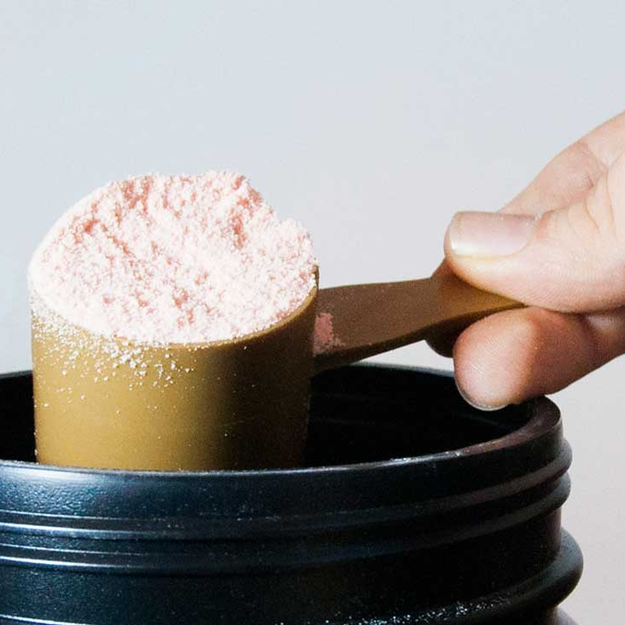
Whey Protein
Most people know that protein is an important muscle component. Several studies have shown slightly more muscle gain in exercising adults who consumeprotein supplementsas part of their diet. However, the most important factor is likely your total daily protein intake rather than whether it comes from foods or supplements. As a general recommendation, the Institute of Medicine suggests that 10–35% of your daily calories should come from protein.

Slide 3
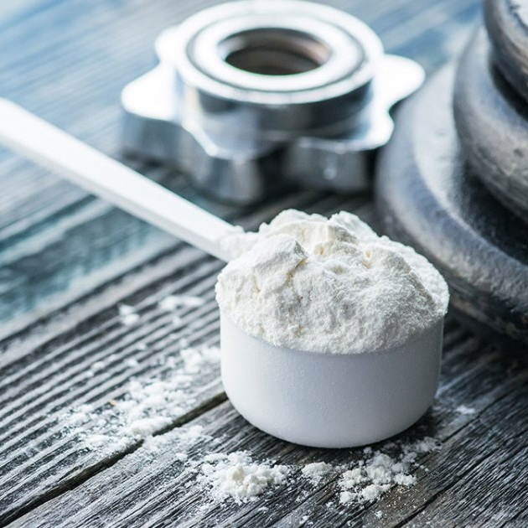
Creatine
Creatine is considered one of the best supplements available when it comes to building muscle. The evidence suggests that creatine supplementation can help you gain nearly twice as much muscle mass than if you didn’t use it.
The exact mechanisms for the increase in muscle mass are unclear when using creatine, however, it’s speculated that these gains may be due to an increased capacity to perform a larger amount of high quality training.
With full creatine stores, you will be able to push out extra reps and improve recovery between sets. In time, this will amount to more muscle gain.

Slide 4
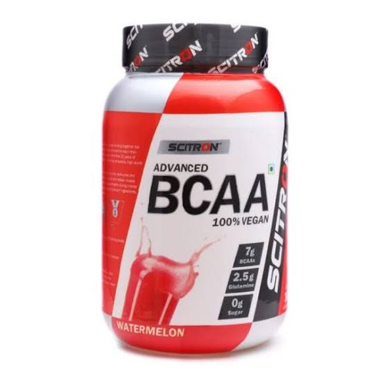
BCAA
BCAAs, also known as branch-chained amino acids, contain leucine, which acts as a ‘trigger’ to enhance muscle protein synthesis rates.
BCAAs have also been shown to ‘rescue’ a meal low in protein and provide a similar increase in muscle protein synthesis rates if taken alongside a meal low in protein.
This makes BCAAs a great option for those looking to gain muscle whilst following a vegetarian or vegan diet.

Slide 5
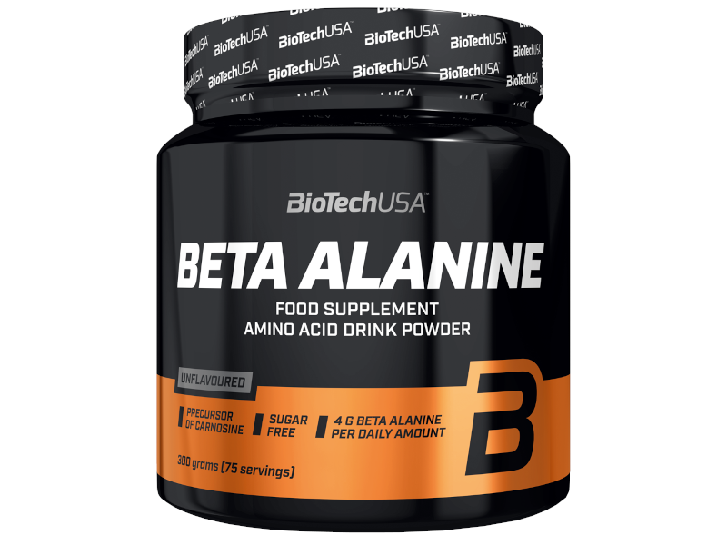
Beta-Alanine
Beta-alanine is an amino acid that reduces fatigue and may increase exercise performance
Additionally, beta-alanine may help increase muscle mass if you are following an exercise program.
One study showed that taking 4 grams of beta-alanine per day for eight weeks increased lean body mass more than a placebo in college wrestlers and football players

Slide 6
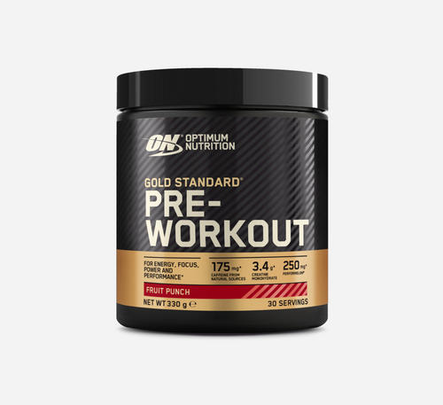
Pre workout
Pre-Workout are consumed before workout or training to enhance your performance. They help you re-energize before you start your routine workout. Pre-workout supplements have grown incredibly popular with people who are trying to boost their performance before hitting the gym or field.

Slide 7


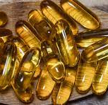
Fish oil
Fish oil is commonly taken to promote heart, brain, eye, and joint health.
Yet, bodybuilders and other athletes also utilize this popular supplement for its anti-inflammatory properties. Some people believe it may boost muscle strength, improve range of motion, and provide numerous other benefits.

Slide 8
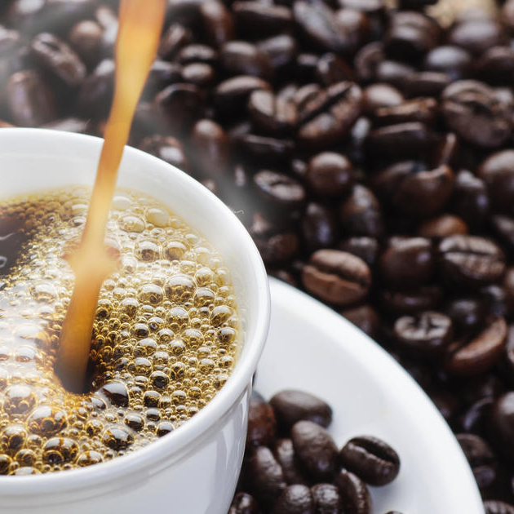
Caffeine
Caffeineis the most commonly consumedpsychoactive substance in the world It is found naturally incoffee, green tea anddark chocolate, and added to many processed foods and beverages. Caffeine is a well knownbooster, andis often added tometabolismcommercial weight loss supplements.

